Slide 1
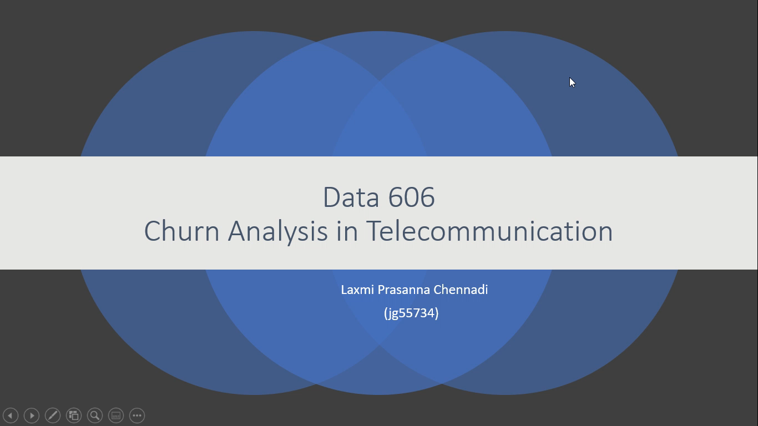
Data 606
Churn Analysis in Telecommunication
Laxmi Prasanna Chennadi
(jg55734)

Slide 2
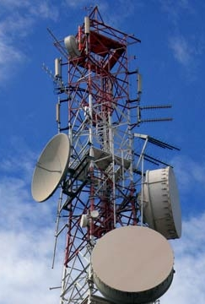
Introduction
Current dataset is Telecom churn data which includes various parameters that effect churn.
Definition: The number of Customers leaving the current company and moving to another is known as CHURN in telecommunication .
Dataset comprises of 21 columns, which include State, account length, area code, phone number, international plan, voice mail plan, number of voicemail messages, total day minutes, total day calls, day charge, evening minutes, eve calls, evening charge, night minutes, night charge, international minutes, intl calls, intl charge, customer service calls, churn.
Source: https://www.kaggle.com/becksddf/churn-in-telecoms-dataset

Slide 3
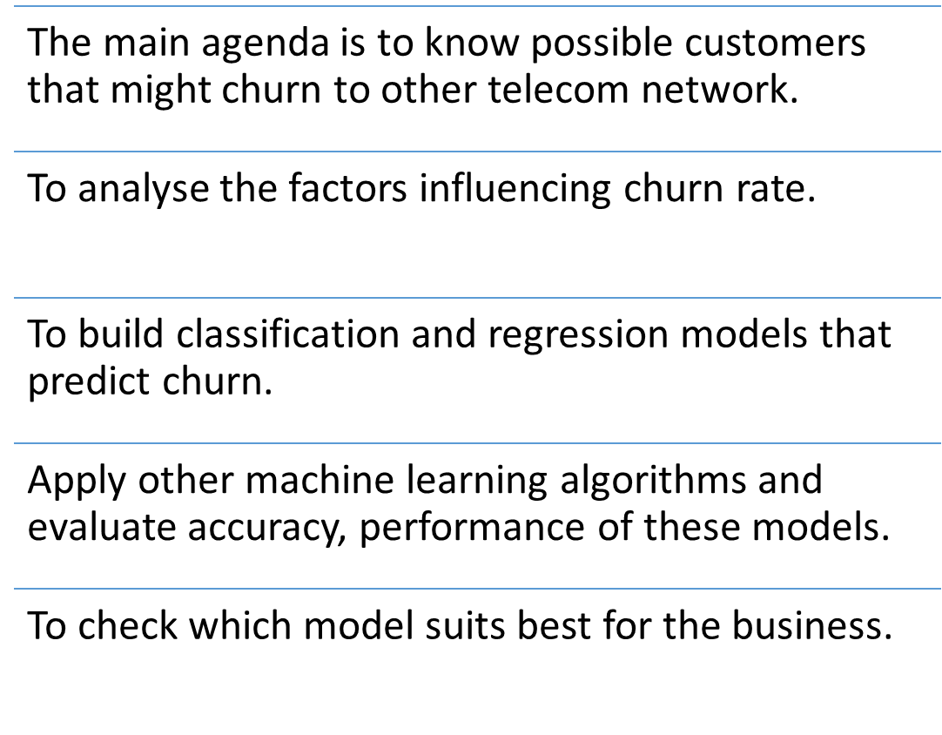
Objective

Slide 4
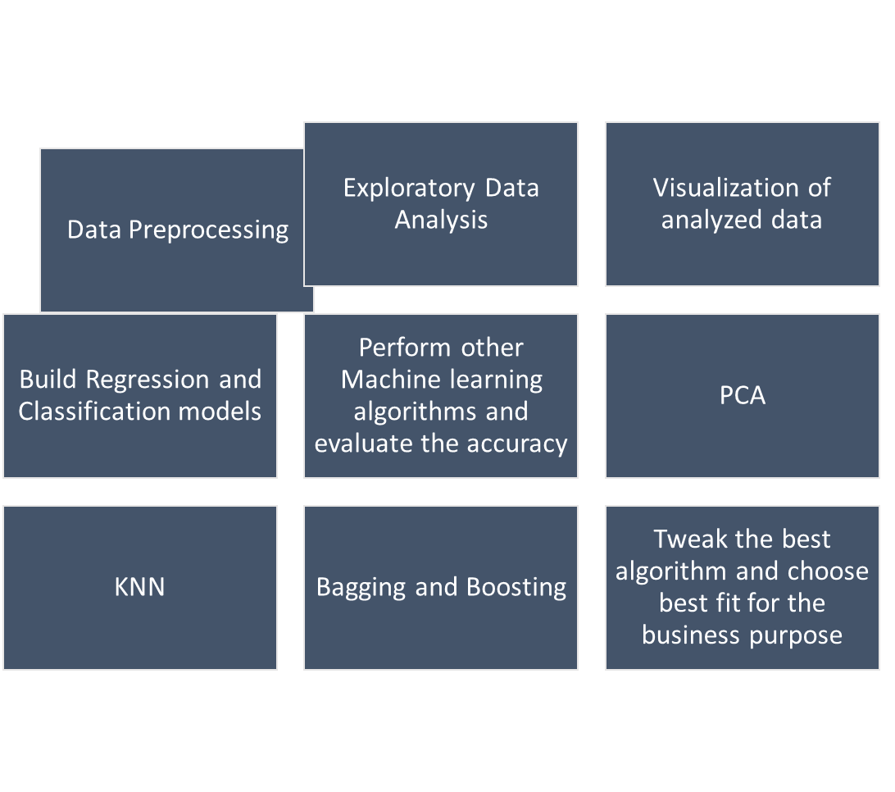
Methodology

Slide 5
Thankyou.

